Slide 1
Fuzzy c-means Clustering Algorithm
An extension of k-means
This method (developed by Dunn in 1973 and improved by Bezdek in 1981) is frequently used in pattern recognition. It is based on minimization of the following objective function:
Hierarchical, k-means generates partitions
  each data point can only be assigned in one cluster
Fuzzy c-means allows data points to be assigned into more than one cluster
  each data point has a degree of membership (or probability) of belonging to each cluster
Notes:
Compare degrees of memberships in k-means and fuzzy c-means

Slide 2
Fuzzy c-means algorithm
This algorithm works by assigning membership to each data point corresponding to each cluster center on the basis of distance between the cluster center and the data point.
More the data is near to the cluster center more is its
membership towards the particular cluster center. Clearly, summation of membership of each data point should be equal to one.
After each iteration membership and cluster centers are updated according to the formula:

Slide 3
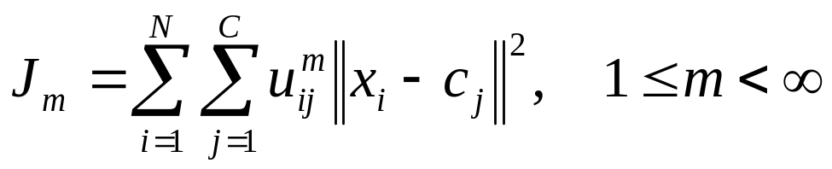
Fuzzy c-means algorithm
Main objective of fuzzy c-means algorithm is to minimize:
Algorithmic steps for Fuzzy c-means clustering
Let X = {x₁, x₂, x₃ ..., x_{n}} be the set of data points and V = {v₁, v₂, v₃ ..., v_{c}} be the set of centers.
1) Randomly select ‘c’ cluster centers.
2) Calculate the fuzzy membership 'µ_{ij}' using:
where m is any real number greater than 1,
u_{ij} is the degree of membership of x_{i} in the cluster j,
xi is the ith of d-dimensional measured data,
cj is the d-dimension center of the cluster,
and ||*|| is any norm expressing the similarity between any measured data and the center.

Slide 4
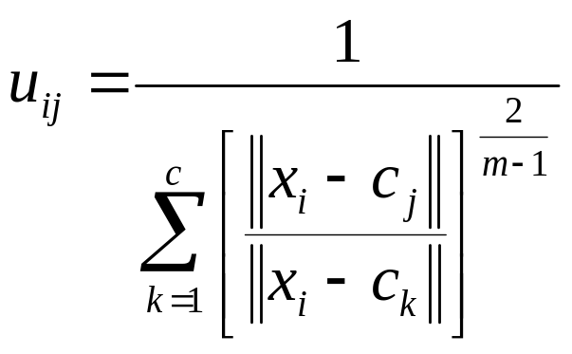
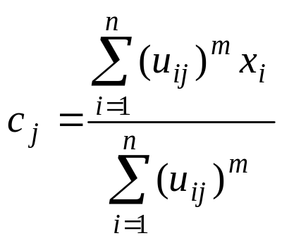
Fuzzy c-means algorithm
Fuzzy partitioning is carried out through an iterative optimization of the objective function shown above, with the update of membership u_{ij} and the cluster centers c_{j} by:

Slide 5
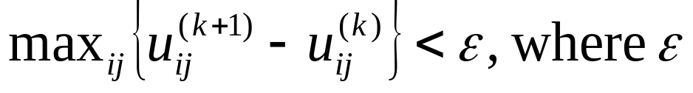

Fuzzy c-means algorithm
This iteration will stop when
is the termination criterion between 0 and 1, whereas k are the iteration steps. This procedure converges to a local minimum or a saddle point of .
The algorithm is composed of the following steps:
Initialize U=[u_{ij}] matrix, U⁽⁰⁾
At k-step: calculate the centers vectors C^{(k)}=[c_{j}] with U^{(k)}
^{Update U(k) , U(k+1)}

Slide 6

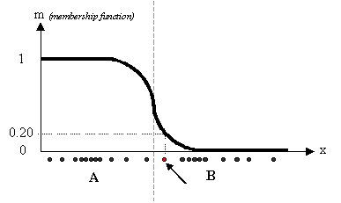
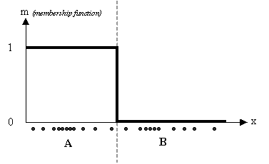
Fuzzy c-means algorithm
If || U^{(k+1)} - U^{(k)}||< then STOP; otherwise return to step 2.
FCM approach membership coefficient.

Slide 7

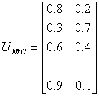
Fuzzy c-means algorithm
the datum shown as a red marked spot belongs more to the B cluster rather than the A cluster.
matrix U whose factors are the ones taken from the membership functions:

Slide 8
Fuzzy c-means
Pros:
  Allows a data point to be in multiple clusters
  A more natural representation of the behavior of genes
    genes usually are involved in multiple functions
Cons:
  Need to define c, the number of clusters
  Need to determine membership cutoff value
  Clusters are sensitive to initial assignment of centroids
    Fuzzy c-means is not a deterministic algorithm

Slide 9
Case Study
MRI Fuzzy Segmentation of Brain Tissue using Fuzzy c-means algorithm
Abstract—
Image segmentation is an indispensable process in the visualization of human tissues, particularly during clinical analysis of magnetic resonance (MR) images. Unfortunately, MR images always contain a significant amount of noise caused by operator performance, equipment, and the environment, which can lead to serious inaccuracies with segmentation.
A robust segmentation technique based on an extension to the traditional fuzzy c-means (FCM) clustering algorithm is proposed in this paper. A neighborhood attraction, which is dependent on the relative location and features of neighboring pixels, is shown to improve the segmentation performance dramatically.
The degree of attraction is optimized by a neural-network model. Simulated and real brain MR images with different noise levels are segmented to demonstrate the superiority of the proposed technique compared to other FCM-based methods. This segmentation method is a key component of an MR image-based classification system for brain tumors, currently being developed

Slide 10
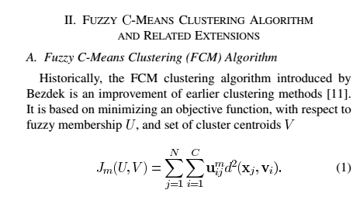
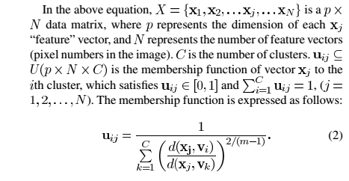

Slide 11
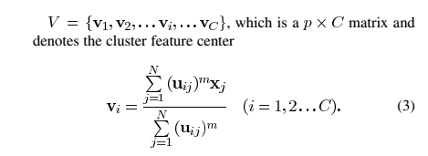
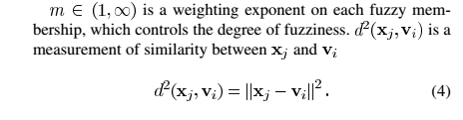
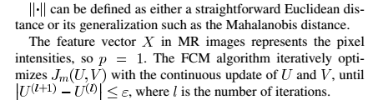

Slide 12

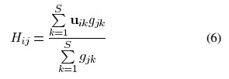
IFCM considers the neighborhood attraction in directly
where H_{ij} represents the feature attraction and represents the distance attraction. The two parameters and in (5), of magnitude between 0 to 1, adjust the degree of the two neighborhood attractions.
Where g_{jk} is the intensity difference between the study pixel J and its neighbor pixel K

Slide 13

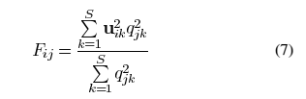
U_{ij} is the membership of neighboring pixel K to the ith cluster, and S is the number of neighboring pixels

Slide 14

Where q_{jk} is the relative location between pixel J and its neighborhood pixel K
The neighborhood structure is of the form

Slide 15

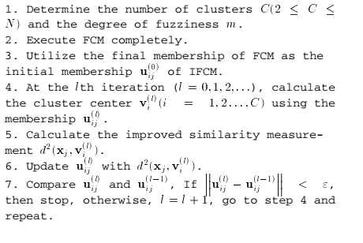

Slide 16
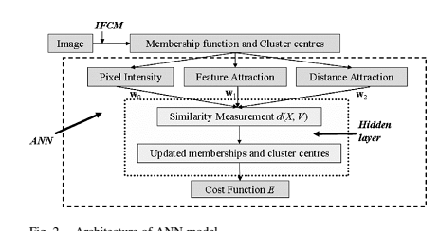

Slide 17
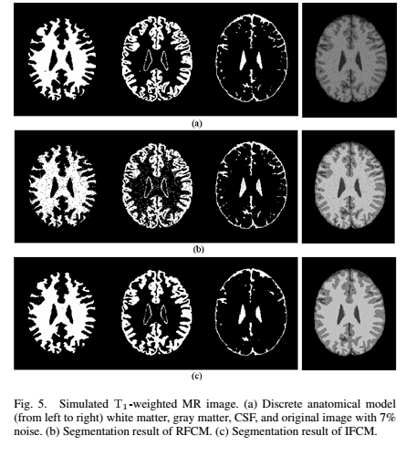

Slide 18
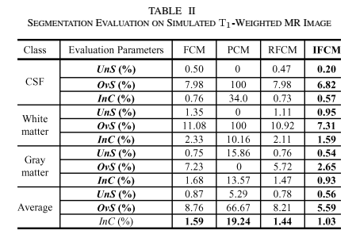

Slide 19
Implementation Fuzzy c-means algorithm (clusterpixel)
function [center, U, obj_fcn] = clusterpixel(lgdata, cluster_n, options)
if nargin ~= 2 & nargin ~= 3,
error('Too many or too few input arguments!');
end
lgdata_n = size(lgdata, 1);
in_n = size(lgdata, 2);
default_options = [2; % exponent for the partition matrix U
25; % max. number of iteration
1e-5; % min. amount of improvement
1]; % info display during iteration

Slide 20
Implementation Fuzzy c-means algorithm
if nargin == 2,
options = default_options;
else
if length(options) < 4,
tmp = default_options;
tmp(1:length(options)) = options;
options = tmp;
end
nan_index = find(isnan(options)==1);
options(nan_index) = default_options(nan_index);
if options(1) <= 1,
error('The exponent should be greater than 1!');
end
end

Slide 21
Implementation Fuzzy c-means algorithm
expo = options(1); % Exponent for U
max_iter = options(2); % Max. iteration
min_impro = options(3); % Min. improvement
display = options(4); % Display info or not
obj_fcn = zeros(max_iter, 1);
load InitProb
for i = 1:max_iter,
[U, center, obj_fcn(i)] = update_cluster(lgdata, U, cluster_n, expo);
% plot(U)
if display,
fprintf('Iteration count = %d, obj. fcn = %f\n', i, obj_fcn(i));
end

Slide 22
Implementation Fuzzy c-means algorithm
if i > 1,
if abs(obj_fcn(i) - obj_fcn(i-1)) < min_impro, break; end,
end
end
iter_n = i;
obj_fcn(iter_n+1:max_iter) = [];

Slide 23
Implementation Fuzzy c-means algorithm (update_cluster)
function [U_new, center, obj_fcn] = update_cluster(datasample, U, cluster_n, expo)
mf = U.^expo;
% MF matrix after exponential modificationcenter = mf*datasample./((ones(size(datasample, 2), 1)*sum(mf'))');
% new center%************************************************
  load neighload stpixcoordlambda = 0.4;
  epsilon = 0.6;
  out = zeros(size(center, 1), size(datasample, 1));
  if size(center, 2) == 1,
  for k = 1:size(center, 1)
  out(k, :) = abs(center(k)-datasample)';
  endelse

Slide 24
Implementation Fuzzy c-means algorithm
for k = 1:size(center, 1),
for v = 1:numel(datasample)
den = sum(datasample(v,1) - neigh(v,:));
nume = sum( mf(:,v)' .* abs ( datasample(v,1) - neigh(v,:) ) );
Hij = nume/den;
save Hij Hij
Qtemp = stpixcoord(v,:);
L = [Qtemp(1,1),Qtemp(1,2)-1];
R = [Qtemp(1,1),Qtemp(1,2)+1];
T = [Qtemp(1,1)-1,Qtemp(1,2)];
B = [Qtemp(1,1)+1,Qtemp(1,2)];
Qjk2 = [(sum((Qtemp-L).^2))^2 ;
(sum((Qtemp-R).^2))^2 ;
(sum((Qtemp-T).^2))^2;
(sum((Qtemp-B).^2))^2]
Qden = sum(Qjk2);
Qnume = sum( Qjk2 .* mf(:,v) );
Fij = Qnume/Qden;

Slide 25
Implementation Fuzzy c-means algorithm
feaattract = 1- (lambda * Hij) - (epsilon * Fij );
out(k,v) = (abs(center(k)-datasample(v,1))) * feaattract;
end
endenddist = out;
save out out
%************************************************************************
obj_fcn = sum(sum((dist.^2).*mf));
% objective functiontmp = dist.^(-2/(expo-1));
U_new = tmp./(ones(cluster_n, 1)*sum(tmp));
feaattract = 1- (lambda * Hij) - (epsilon * Fij );
out(k,v) = (abs(center(k)-datasample(v,1))) * feaattract;
end
endenddist = out;
save out out
%************************************************************************
obj_fcn = sum(sum((dist.^2).*mf));
% objective functiontmp = dist.^(-2/(expo-1));
U_new = tmp./(ones(cluster_n, 1)*sum(tmp));

Slide 26
Implementation Fuzzy c-means algorithm Main Program
[filename pathname] = uigetfile('*.jpg','Select the MRI image');
mrgimg = imread([pathname filename]);
mrgimg = imresize(mrgimg,[256 256]);
[m n c] = size(mrgimg);
if c == 3
mrgimg = rgb2gray(mrgimg);
end
figure(1),
imshow(mrgimg);
title('Original Image');
axis off
%********************Neighbour Computation*************
repim = zeros(m+2,n+2);
[R C] = size(repim);
repim(2:R-1,2:C-1) = mrgimg(1:end,1:end);
neigh = zeros(m*n,4);
k = 1;
for i = 2:R-1
for j = 2:C-1
neigh(k,:) = [repim(i,j-1),repim(i,j+1),repim(i-1,j),repim(i+1,j)];
k = k+1;
end

Slide 27
Implementation Fuzzy c-means algorithm Main Program
end
neigh = double(neigh);
save neigh neigh
%*****************************************************
stpixcoord = zeros(numel(mrgimg),2);
co = 1;
for rl = 1:m
for cl = 1:n
stpixcoord(co,:) = [rl,cl];
co = co+1;
end
end
save stpixcoord stpixcoord
%*******************Segmentation***********************
noclus = 4;
data = im2double(mrgimg);
datavec = reshape(data',m*n,1);
%&&&&&&&&&&&&&&&&&&&&&&&&&&&&&&&&
[center,U,obj_fcn] = clusterpixel(datavec,noclus);
%&&&&&&&&&&&&&&&&&&&&&&&&&&&&&&&&
figure(2),
plot(U),

Slide 28
Implementation Fuzzy c-means algorithm Main Program
%*******************Segmentation***********************
noclus = 4;
data = im2double(mrgimg);
datavec = reshape(data',m*n,1);
%&&&&&&&&&&&&&&&&&&&&&&&&&&&&&&&&
[center,U,obj_fcn] = clusterpixel(datavec,noclus);
%&&&&&&&&&&&&&&&&&&&&&&&&&&&&&&&&
figure(2),
plot(U),
title('Fuzzy Membership Function');
xlabel('Cluster Partition');
ylabel('Membership')
figure(3),
plot(obj_fcn);
title('Objective Function');
xlabel('Iteration');
ylabel('Cost Function');
maxU = max(U);

Slide 29
Implementation Fuzzy c-means algorithm Main Program
index1 = find(U(1,:) == maxU);
index2 = find(U(2,:) == maxU);
index3 = find(U(3,:) == maxU);
index4 = find(U(4,:) == maxU);
% index5 = find(U(5,:) == maxU);
% index6 = find(U(6,:) == maxU);
fcmImage(1:length(data))=0;
fcmImage(index1)= 1;
fcmImage(index2)= 0.8;
fcmImage(index3)= 0.6;
fcmImage(index4)= 0.4;
% fcmImage(index5)= 0.2;
% fcmImage(index6)= 0;

Slide 30
Implementation Fuzzy c-means algorithm Main Program
imagNew = reshape(fcmImage,256,256);
figure(4),
imshow(imagNew',[]);impixelinfo;
title('Segmented Image');
%^^^^^^^^^^^^^^^^^Segmentation Evaluation^^^^^^^^^^^^^^^^^^^^^^^^^^^^^^^^^^^
x = imagNew';
same = unique(x);
[M N] = size(same);
res = zeros(M,N);
for i = 1:size(same,1)
count = 0;
for j = 1:size(x,1)
for k = 1:size(x,2)
if x(j,k) == same(i,1)
count = count+1;
end
end
end
res(i,1) = count;
end
result = [same res];

Slide 31
Implementation Fuzzy c-means algorithm Main Program
figure5 = figure('NumberTitle','off','Name','Segmentation Evaluation');
columnname = {'Label','Pixel Count'};
columnformat = {'numeric'};
columneditable = [false];
t = uitable('Units','normalized','Position',...
[0.1 0.1 0.4 0.9], 'Data', result,...
'ColumnName', columnname,...
'ColumnFormat', columnformat,...
'ColumnEditable', columneditable,...
'RowName',[]);

Slide 32
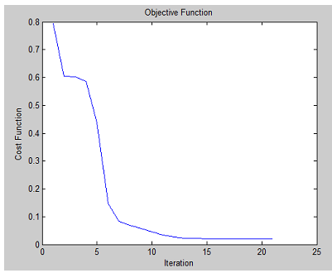
Objective function of FCM

Slide 33
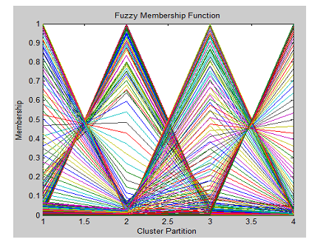
Fuzzy Membership function

Slide 34
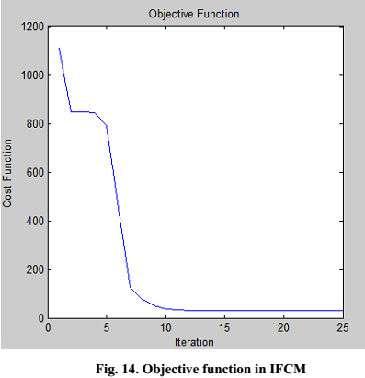
Objective function of IFCM

Slide 35
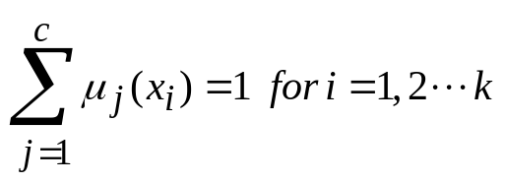
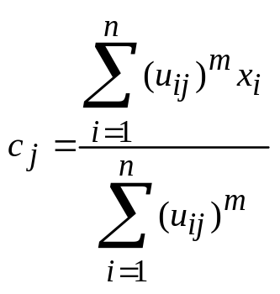
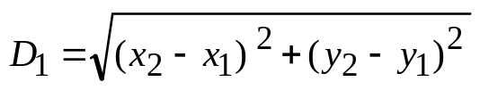
Worked Example
Step-1 Randomly Initialize the membership matrix using the equation
Step-2 Calculate the centroid using the equation
Step-3 Calculate the dissimilarity between data points and centroid using Euclidean distance
X | Y | C1 | C2
1 | 6 | 0.8 | 0.2
2 | 5 | 0.9 | 0.1
3 | 8 | 0.7 | 0.3
4 | 4 | 0.3 | 0.7
5 | 7 | 0.5 | 0.5
6 | 9 | 0.2 | 0.8

